Slide 1
BANKING BOT
TEAM MEMBERS
S.DHARSHINI(711714104016)
S.GOWRI GAYATHRI(711714104021)
K.KHAVYA(711714104030)
N.KOWSALYA(711714104031)
FACULTY GUIDE
Ms.PRISCILLA JOY
INDUSTRY GUIDE
Mr.VASANTH
Department of CSE, KGiSL Institute of Technology, Coimbatore

Slide 2
Abstract
Banking bot is an artificial intelligent develop for banking operations, who understand people queries and responds accordingly.
The main aim of this project is to develop a banking bot using artificial intelligent algorithms which should be able to analyze and understand user’s queries and react accordingly.
For any banking related queries we have to go to the bank or call to customer care. It takes lot of time and effort and bank people are also very busy to attend our queries. On the other hand we don’t get complete information from the customer care executives.
It will be more suitable if we can directly post our queries online or chat with the bank people and get the response with no time. To overcome the problem we proposed banking bot where people can directly chat with a bot.
Department of CSE, KGiSL Institute of Technology, Coimbatore

Slide 3
Area Introduction-Existing system
Improper and ineffectual.
Time consuming and draggy.
Less flexible
Disadvantages in CAN MOBILE Application
Message request cant be sent if there is low balance
Joint Users can’t create an account in application
MPIN request and validation is a tedious process
Department of CSE, KGiSL Institute of Technology, Coimbatore

Slide 4
Proposed System
Formatless.
Bot understand all banking terminologies and operations.
Other informations like address of the different branches in different cities, ATM location in various places etc.
Department of CSE, KGiSL Institute of Technology, Coimbatore

Slide 5
Future enhancements
Information of many banks.
voice recognition mechanism.

Slide 6
Literature Review
Literatures | Reviews
http://freeprojectsreport.com/2016/11/ai-banking-bot-project.html | Frame work
http://nevonprojects.com/banking-bot-project/ | Customer care
http://ieeexplore.ieee.org/xpl/RecentIssue.jsp?punumber=4804728 | chating
https://chatbotsmagazine.com/ | Chat bot
Department of CSE, KGiSL Institute of Technology, Coimbatore

Slide 7
Module Split up
ADDING A BENEFICIERY
FUND TRANSFER
MINI STATEMENT
BALANCE
Department of CSE, KGiSL Institute of Technology, Coimbatore

Slide 8
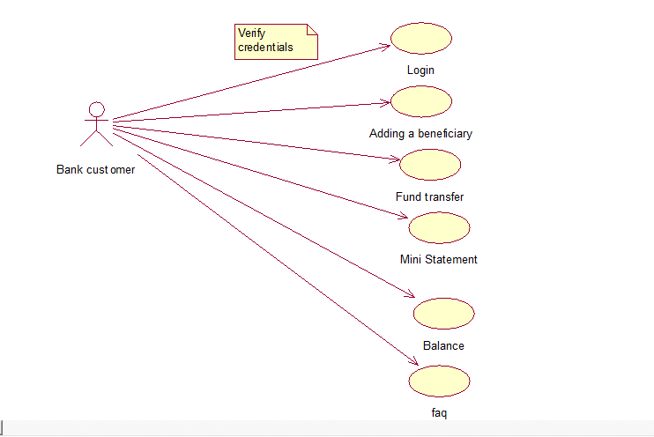
Banking bot-Use Case

Slide 9
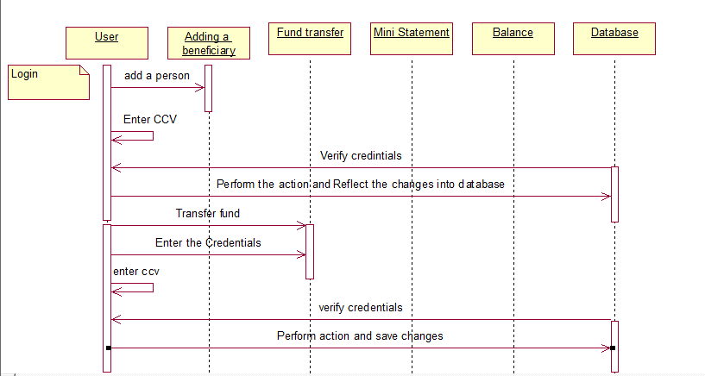
Flow Diagram

Slide 10
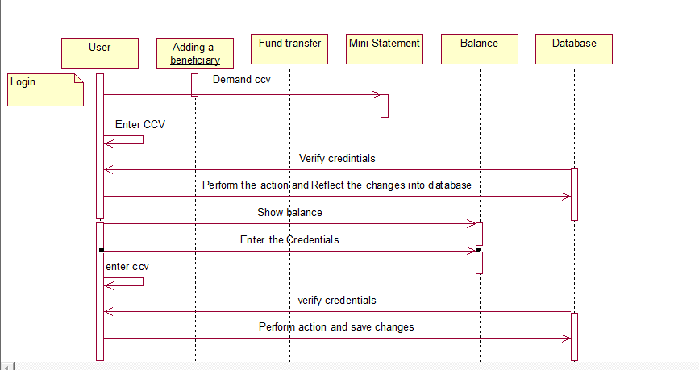
contd

Slide 11
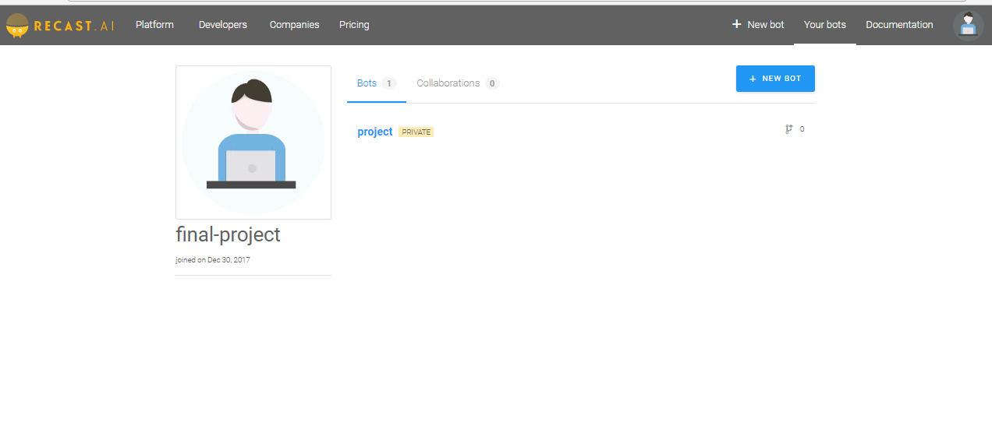
Screen shots of modules under progress.

Slide 12
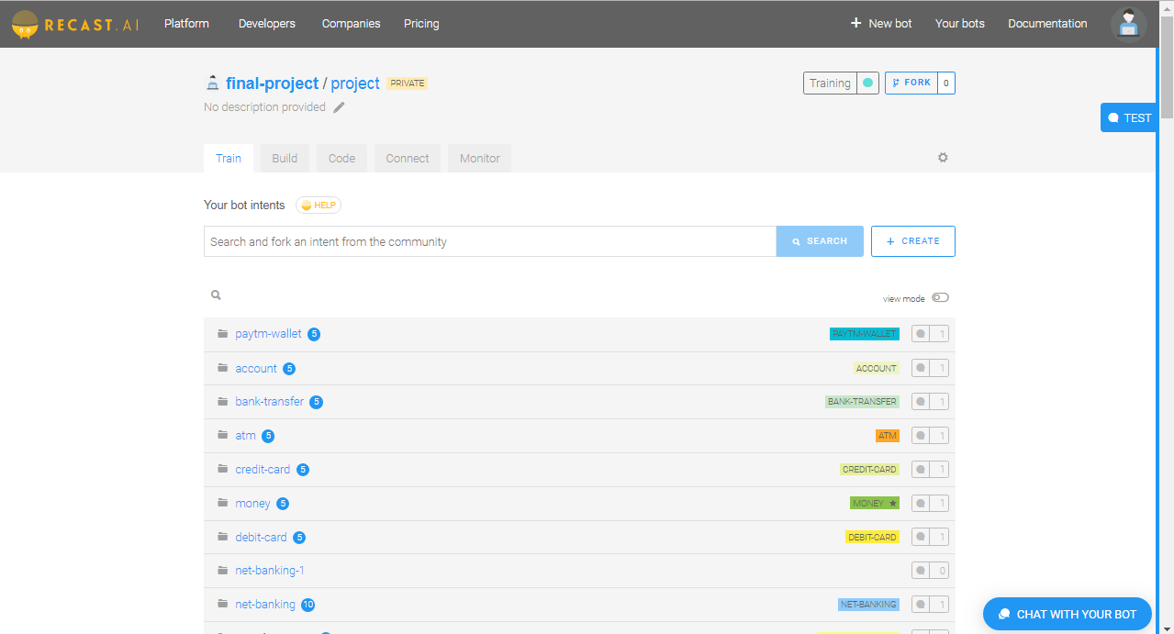
Intent creation-Training the bot

Slide 13
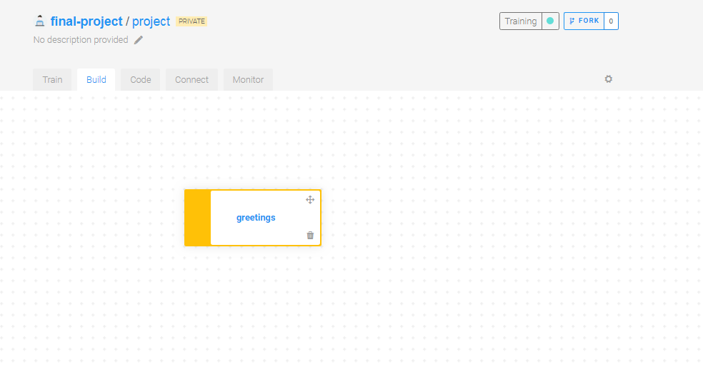
Build section

Slide 14
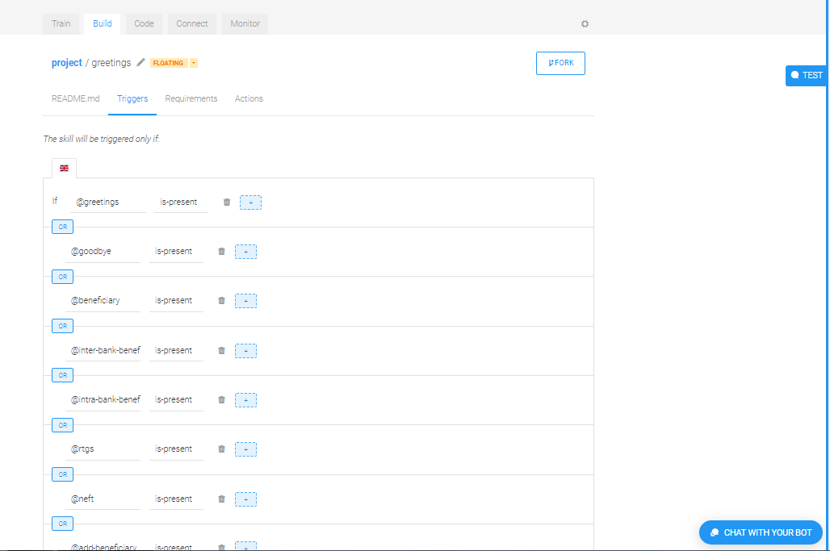
Entities-creation

Slide 15
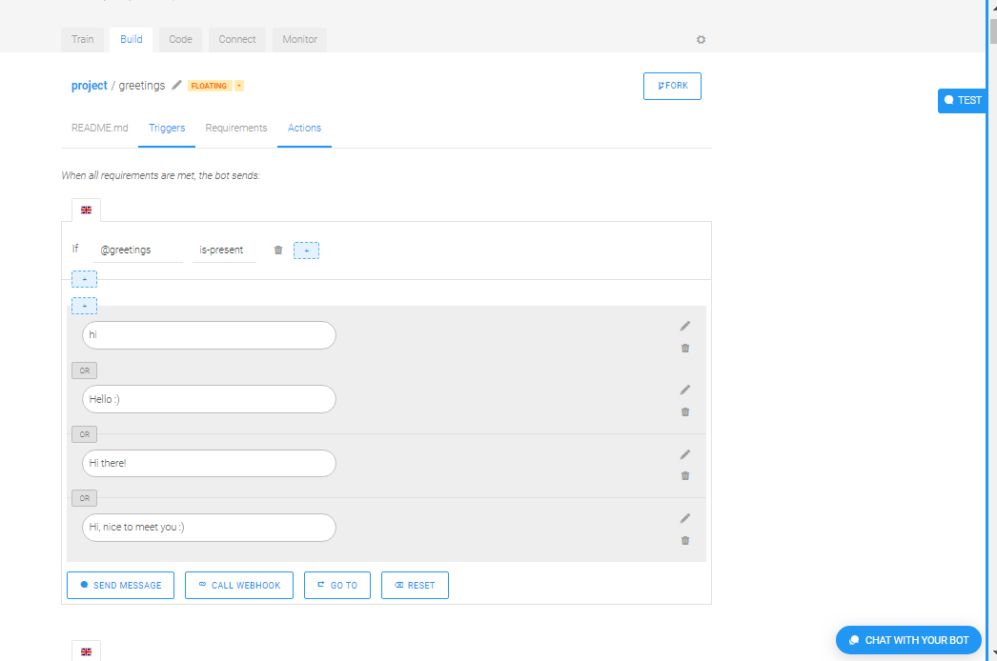
Mapping with the entities

Slide 16
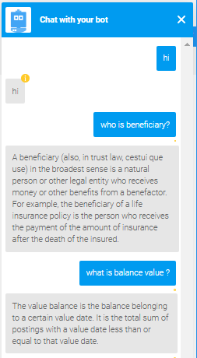
Building the conversation

Slide 17
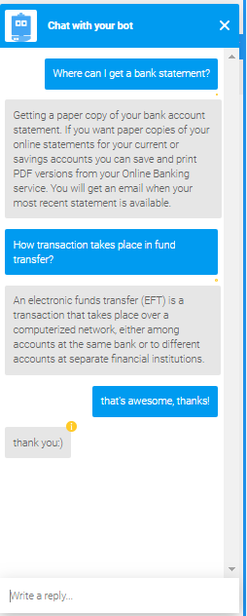
Contd..

Slide 18
Project Planner / Timeline (Gantt chart)
Particulars | Dec-15 |  |  |  | Jan-16 |  |  |  | FEb-16 |  |  |  | Mar-16 |  |  |  | April
 | Wk 1 | Wk 2 | Wk 3 | Wk 4 | Wk 1 | Wk 2 | Wk 3 | Wk 4 | Wk 1 | Wk 2 | Wk 3 | Wk 4 | Wk 1 | Wk 2 | Wk 3 | Wk 4 | Wk 1
Problem Identification
Literature Survey
Module 1
Module 2
Module 3
Module 4
Thesis Draft
Final Thesis
Viva
Department of CSE, KGiSL Institute of Technology, Coimbatore

Slide 19
Thank you…

